Slide 1
UNIT 5 (File Organization)
Java I/O (FILES)

Slide 2
Contents
Unit V Syllabus Topic List
File Types
How to Handle Files in Java
File class
Using File Streams
Using Scanner class, PrintStream and Buffering
Serialization and Using Object Streams
Sample code: Student Database

Slide 3
Unit V : Topic List
File Handling and Organization in Java
Java I/O Classes and interfaces
Files in Java
Stream: Byte Stream, Character Stream
Util class

Slide 4
File Types: Binary Files, Text Files

Slide 5
Binary Versus Text Files
All data and programs are ultimately just zeros and ones
each digit can have one of two values, hence binary
bit is one binary digit
byte is a group of eight bits
Text files: the bits represent printable characters
one byte per character for ASCII, the most common code
for example, Java source files are text files
so is any file created with a "text editor"
Binary files: the bits represent other types of encoded information, such as executable instructions or numeric data
these files are easily read by the computer but not humans
they are not "printable" files
actually, you can print them, but they will be unintelligible
"printable" means "easily readable by humans when printed"

Slide 6
Java: Text Versus Binary Files
Text files are more readable by humans
Binary files are more efficient
computers read and write binary files more easily than text
Binary files created by C, C++ are not portable(.obj are readable on specific architecture)
Java binary files are portable (.class has byte codes and it works on any platform)
they can be used by Java on different machines
Reading and writing binary files is normally done by a program
text files are used only to communicate with humans
Java Text Files
Source files
Occasionally input files
Occasionally output files
Java Binary Files
Executable files (created by compiling source files)
Usually input files
Usually output files

Slide 7
Text Files vs. Binary Files
Memory Requirement-
Number: 127 (decimal)
Text file
Three bytes(character): “1”, “2”, “7”
ASCII (decimal): 49, 50, 55
ASCII (octal): 61, 62, 67
ASCII (binary): 00110001, 00110010, 00110111
Binary file:
One byte (byte): 01111110
Two bytes (short): 00000000 01111110
Four bytes (int): 00000000 00000000 00000000 01111110

Slide 8
Text file: an example
127 smiley
faces
0000000 061 062 067 011 163 155 151 154
1 2 7 \t s m i l
0000010 145 171 012 146 141 143 145 163
e y \n f a c e s
0000020 012
\n

Slide 9
Binary file: an example [a .class file]
0000000 312 376 272 276 000 000 000 061
312 376 272 276 \0 \0 \0 1
0000010 000 164 012 000 051 000 062 007
\0 t \n \0 ) \0 2 \a
0000020 000 063 007 000 064 010 000 065
\0 3 \a \0 4 \b \0 5
0000030 012 000 003 000 066 012 000 002
\n \0 003 \0 6 \n \0 002
...
0000630 000 145 000 146 001 000 027 152
\0 e \0 f 001 \0 027 j
0000640 141 166 141 057 154 141 156 147
a v a / l a n g
0000650 057 123 164 162 151 156 147 102
/ S t r i n g B
0000660 165 151 154 144 145 162 014 000
u i l d e r \f \0

Slide 10
Text Vs. Binary Files
Text files are bulky as compared to binary files.
Ascii values of space, enter key also get stored in text files.
EOF when get detected that is explicitly get stored in text files but not in binary file.
Binary files are more efficient than Text files.

Slide 11
Text File I/O
Important classes for text file output (to the file)
PrintWriter (Note-First letter should be capital otherwise it gives error)
FileOutputStream [or FileWriter]
Important classes for text file input (from the file):
BufferedReader
FileReader
FileOutputStream and FileReader take file names as arguments.
PrintWriter and BufferedReader provide useful methods for easier writing and reading.
To use these classes your program needs a line like the following:
import java.io.*;

Slide 12
Unit VI : Topics
File Handling and Organization in Java
Java I/O Classes and interfaces
Files in Java
Stream: Byte Stream, Character Stream
Util class

Slide 13
Using Files in Java

Slide 14
Java API for Reading and Writing Files
Many available classes
FileReader,
BufferedReader,
File,
Scanner,
FileInputStream,
FileWriter,
BufferedWriter,
FileOutputStream, etc.
Which one to use?
Your Java version
Your Need to read/write bytes or characters(text)
Size of the file/lines etc.

Slide 15
Methods for Handling Files in JAVA
File class (in java.io package) object
Using File Streams Classes
(i) FileInputStream and FileOutputStream
(ii) FileReader and FileWriter
More Topics : Using Scanner class, Buffering, Serialization

Slide 16
(I) File class (in java.io package) object used to handle a file

Slide 17
File Class in Java
The File Class allows us to work with files
To use the File class, create an object of the class, and specify the filename or directory name:

Slide 18
Package and File Class
Package : java.io package
Class : Java File class
Object of file class to be created for use
EXAMPLE:
// Import the File class
import java.io.File;
// Object with file name - Ass3.txt
File firstfileObj = new File("Ass3.txt");

Slide 19
Using Path Names
Path name—gives name of file and tells which directory the file is in
Relative path name—gives the path starting with the directory that the program is in
Typical UNIX path name:
/user/smith/home.work/java/FileClassDemo.java
Typical Windows path name:
D:\Work\Java\Programs\FileClassDemo.java
When a backslash is used in a quoted string it must be written as two backslashes since backslash is the escape character:
"D:\\Work\\Java\\Programs\\FileClassDemo.java"
Java will accept path names in UNIX or Windows format, regardless of which operating system it is actually running on.

Slide 20
File Class [java.io]
Acts like a wrapper class for file names
A file name like “Ass3.txt" has only String properties
File has some very useful methods
exists: tests if a file already exists
canRead: tests if the OS will let you read a file
canWrite: tests if the OS will let you write to a file
delete: deletes the file, returns true if successful
length: returns the number of bytes in the file
getName: returns file name, excluding the preceding path
getPath: returns the path name—the full name
File numFile = new File(“Ass3.txt”);
if (numFile.exists())
System.out.println(numfile.length());

Slide 21
File Class Methods
Method | Return Type | Description
canRead() | Boolean | The canRead() method is used to check whether we can read the data of the file or not.
createNewFile() | Boolean | The createNewFile() method is used to create a new empty file.
canWrite() | Boolean | The canWrite() method is used to check whether we can write the data into the file or not.
exists() | Boolean | The exists() method is used to check whether the specified file is present or not.
delete() | Boolean | The delete() method is used to delete a file.
getName() | String | The getName() method is used to find the file name.
getAbsolutePath() | String | The getAbsolutePath() method is used to get the absolute pathname of the file.
length() | Long | The length() method is used to get the size of the file in bytes.
list() | String[] | The list() method is used to get an array of the files available in the directory.
mkdir() | Boolean | The mkdir() method is used for creating a new directory.

Slide 22
File Class Methods
Some File class methods
METHOD | Return TYPE | Description
getAbsolutePath() | String | Returns the absolute pathname of the file
length() | Long | Returns the size of the file in bytes
exists() | Boolean | Tests whether the file exists
createNewFile() | Boolean | Creates an empty file
delete() | Boolean | Deletes a file
getName() | String | Returns the name of the file
canRead() | Boolean | Tests whether the file is readable or not
canWrite() | Boolean | Tests whether the file is writable or not
list() | String[] | Returns an array of the files in the directory
mkdir() | Boolean | Creates a directory

Slide 23
Create a File, Using File Class

Slide 24
Create a File
Use the Method createNewFile()
Method returns a boolean value:
true if the file was successfully created,
false if the file already exists
Note : Method is enclosed in a try...catch block.
if the file cannot be created for some reason, it throws an IOException for error

Slide 25
////Example Create a File
import java.io.File;
import java.io.IOException;
public class CreateFile {
public static void main(String[] args) {
try {
File firstfileObj = new File(“Ass3.txt");
if (firstfileObj.createNewFile()) {
System.out.println("File created: “+firstfileObj.getName());
}
else {
System.out.println("File already exists.");
}
} catch (IOException e) {
System.out.println("An error occurred.");
e.printStackTrace();
} } }

Slide 26
////Example Create a File in a specified directory
import java.io.File;
import java.io.IOException;
public class CreateFileDir {
public static void main(String[] args) {
try {
File firstfileObj = new File("C:\\ADS\\Assignment\\Ass3.txt");
if (firstfileObj.createNewFile()) {
System.out.println("File created: " + firstfileObj.getName());
System.out.println("Absolute path: " + firstfileObj.getAbsolutePath());
} else {
System.out.println("File already exists.");
}
} catch (IOException e) {
System.out.println("An error occurred.");
e.printStackTrace();
} } }

Slide 27
Get Information about a File
//EXAMPLE
import java.io.File; // Import the File class
public class GetFileInfo { public static void main(String[] args) {
File firstfileObj = new File(“Ass3.txt");
if (firstfileObj.exists()) {
System.out.println("File name: " + firstfileObj.getName());
System.out.println("Absolute path: " + firstfileObj.getAbsolutePath());
System.out.println("Writeable: " + firstfileObj.canWrite());
System.out.println("Readable " + firstfileObj.canRead());
System.out.println("File size in bytes " + firstfileObj.length());
} else {
System.out.println("The file does not exist.");
} }}
OUTPUT:
File name: Ass3.txt Absolute path: C:\ADS\Assignments\Ass3txt Writeable: true Readable: true File size in bytes: 0

Slide 28
Delete a File
import java.io.File;
public class DeleteFile {
public static void main(String[] args) {
File firstfileObj = new File(“Ass3.txt");
if (firstfileObj.delete()) {
System.out.println("Deleted the file: " + firstfileObj.getName());
} else {
System.out.println("Failed to delete the file.");
} } }

Slide 29
Read and print out the contents of a File: Using the Scanner class to read the contents of the text file we created
import java.io.File;
import java.io.FileNotFoundException;
import java.util.Scanner;
public class ReadFile {
public static void main(String[] args) {
try {
File firstfileObj = new File("Ass3.txt");
Scanner myReader = new Scanner(firstfileObj);
while (myReader.hasNextLine()) {
String data = myReader.nextLine();
System.out.println(data);
}
myReader.close();
} catch (FileNotFoundException e) {
System.out.println("An error occurred.");
e.printStackTrace();
} }}

Slide 30
WRITE to a file, and READ from file
Using File Class (Self Study)

Slide 31
File class methods
Some File class methods
METHOD | TYPE | Description
getAbsolutePath() | String | Returns the absolute pathname of the file
length() | Long | Returns the size of the file in bytes
exists() | Boolean | Tests whether the file exists
createNewFile() | Boolean | Creates an empty file
delete() | Boolean | Deletes a file
getName() | String | Returns the name of the file
canRead() | Boolean | Tests whether the file is readable or not
canWrite() | Boolean | Tests whether the file is writable or not
list() | String[] | Returns an array of the files in the directory
mkdir() | Boolean | Creates a directory

Slide 32
(II) Using File Streams
(i)FileInputStream and FileOutputStream
(ii)FileReader – FileWriter, PrintWriter

Slide 33
Byte Streams

Slide 34
Reading and Writing Files (Byte Stream)
Two of the most often-used stream classes are FileInputStream and FileOutputStream, which create byte streams linked to files.
To open a file, you simply create an object of one of these classes, specifying the name of the file as an argument to the constructor.

Slide 35
Basic Binary File I/O
Important classes for binary file output (to the file)
ObjectOutputStream
FileOutputStream
Important classes for binary file input (from the file):
ObjectInputStream
FileInputStream
Note that FileOutputStream and FileInputStream are used only for their constructors, which can take file names as arguments.
ObjectOutputStream and ObjectInputStream cannot take file names as arguments for their constructors.
To use these classes your program needs a line like the following:
import java.io.*;

Slide 36
Reading and Writing Files (Byte Stream)
Although both classes support additional constructors, the following are the forms that we will be using:
FileInputStream(String fileName) throws FileNotFoundException
FileOutputStream(String fileName) throws FileNotFoundException

Slide 37
(EXAMPLE in next slide) Every Text File Has Two Essential Things
the stream name used by Java
outputStream (Used for writing in a file) in the example
the file name used by the operating system
out.txt (Name of file in which we want to write) in the example

Slide 38
Handling IOException
IOException cannot be ignored
either handle it with a catch block
or defer it with a throws-clause
We will put code to open the file and write to it in a try-block and write a catch-block for this exception :
catch(IOException e)
{
System.out.println("Problem with output...";
}

Slide 39
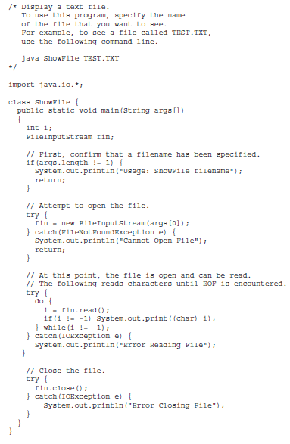

Slide 40
“File” Objects and Filenames
FileInputStream and FileOutputStream have constructors that take a “File” argument as well as constructors that take a String argument
PrintWriter smileyOutStream = new PrintWriter(new FileOutputStream(“smiley.txt”));
File smileyFile = new File(“smiley.txt”);
if (smileyFile.canWrite())
PrintWriter smileyOutStream = new PrintWriter(new FileOutputStream(smileyFile));

Slide 41
Java API for Reading and Writing Files
Many available classes
FileReader,
BufferedReader,
File,
Scanner,
FileInputStream,
FileWriter,
BufferedWriter,
FileOutputStream, etc.
Which one to use?
Your Java version
Your Need to read/write bytes or characters(text)
Size of the file/lines etc.

Slide 42
Character Streams

Slide 43
WRITE to a file, and READ from file
FileWriter

Slide 44
FileWriter Class, write(), close() methods
FileWriter class is used to write character-oriented data to a file.
It is character-oriented class which is used for file handling in java.
Unlike FileOutputStream class, you don't need to convert string into byte array because it provides method to write string directly
FileWriter class, and its write() method can be used to write some text to a created file
Note : a file must be closed, after use in program, with close() method

Slide 45
EXAMPLE - write text to a file:
import java.io.FileWriter;
import java.io.IOException;
public class WriteToFile {
public static void main(String[] args) {
try {
FileWriter myWriter = new FileWriter(“Ass3.txt");
myWriter.write(“Writing to a file in Java!!”);
myWriter.close();
System.out.println("Successfully wrote to the file.");
} catch (IOException e) {
System.out.println("An error occurred.");
e.printStackTrace();
} }}

Slide 46
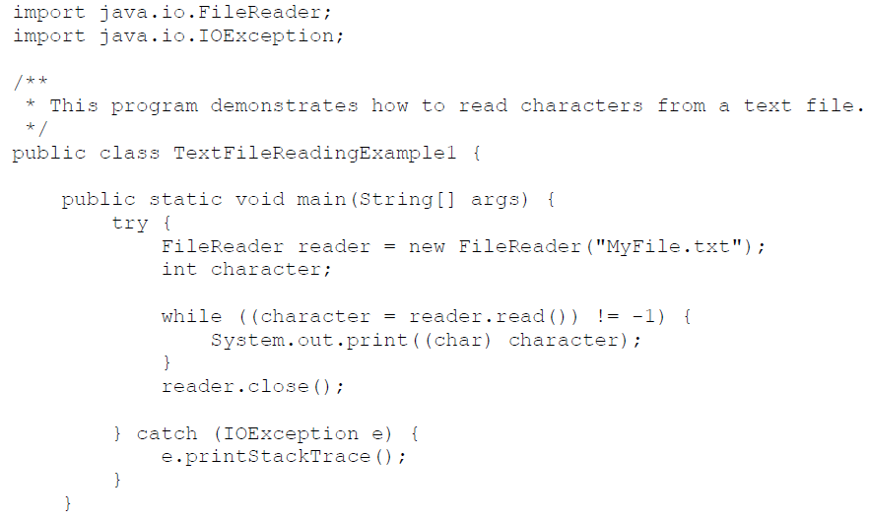

Slide 47
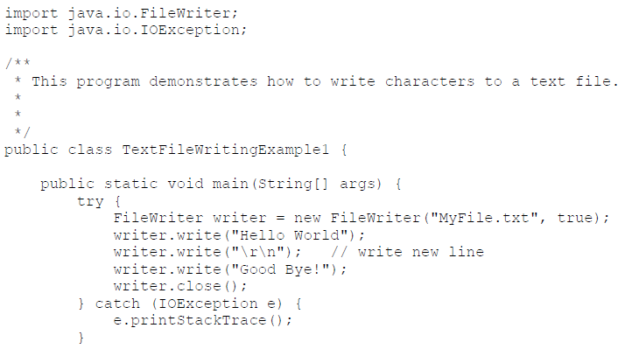

Slide 48
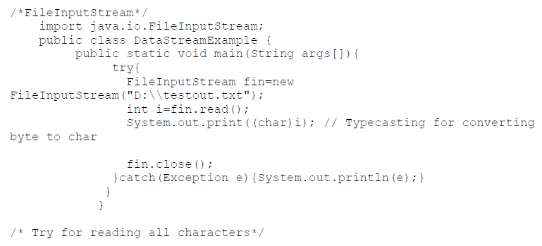

Slide 49
Testing for End of File in a Text File
When readLine tries to read beyond the end of a text file it returns the special value null
so you can test for null to stop processing a text file
read returns -1 when it tries to read beyond the end of a text file
Neither of these two methods (read and readLine) will throw an EOFException.

Slide 50
Example: Using Null to Test for End-of-File in a Text File
When using readLine
test for null
Excerpt from TextEOFDemo
When using read test for -1
50

Slide 51
Using PrintWriter
For Text File Output

Slide 52
TextFileOutputDemo Part 1
A try-block is a block:
outputStream would not be accessible to the rest of the method if it were declared inside the try-block
public static void main(String[] args)
{
PrintWriter outputStream = null;
try
{
outputStream =
new PrintWriter(new FileOutputStream("out.txt"));
}
catch(FileNotFoundException e)
{
System.out.println("Error opening the file out.txt. “
+ e.getMessage());
System.exit(0);
}
Opening the file
Creating a file can cause the FileNotFound-Exception if the new file cannot be made.

Slide 53
TextFileOutputDemo Part 2
System.out.println("Enter three lines of text:");
String line = null;
int count;
for (count = 1; count <= 3; count++)
{
line = keyboard.nextLine();
outputStream.println(count + " " + line);
}
outputStream.close();
System.out.println("... written to out.txt.");
}
Writing to the file
Closing the file
The println method is used with two different streams: outputStream and System.out

Slide 54
(III) Exception Handling

Slide 55
I/O Exceptions
Two exceptions play an important role in I/O handling. (I) IOException (II) SecurityException:
(I) IOException : It relates to many of the I/O classes. If an I/O error occurs, an IOException is thrown.
In many cases, if a file cannot be opened, a FileNotFoundException is thrown.
FileNotFoundException is a subclass of IOException, so both can be caught with a single catch that catches IOException.
In applications, we might find it useful to catch each exception separately.
(II) SecurityException: Another exception class that is sometimes important when performing I/O
In situations in which a security manager is present, several of the file classes will throw a SecurityException if a security violation occurs when attempting to open a file.
By default, applications run via java do not use a security manager.
However, applets will use the security manager provided by the browser, and file I/O performed by an applet could generate a SecurityException. In such a case, we need to handle this exception.

Slide 56
Exception Handling with File I/O
It handles abrupt termination of your program so it is necessary.
Catching IOExceptions
IOException is a predefined class
File I/O might throw an IOException
catch the exception in a catch block that at least prints an error message and ends the program
FileNotFoundException is derived from IOException
therefore any catch block that catches IOExceptions also catches FileNotFoundExceptions
put the more specific one first (the derived one) so it catches specifically file-not-found exceptions
then you will know that an I/O error is something other than file-not-found

Slide 57
Example: Reading a File Name from the Keyboard
reading a file name from the keyboard
using the file name read from the keyboard
closing the file
reading data from the file
Chapter 10
Java: an Introduction to Computer Science & Programming - Walter Savitch
57

Slide 58
Exception - getMessage()
try
{
…
}
catch (FileNotFoundException e)
{
System.out.println(filename + “ not found”);
System.out.println(“Exception: “ +
e.getMessage());
System.exit(-1);
}

Slide 59
(IV) Using Scanner class, PrintStream and Buffering (V) Serialization and Using Object Stream, (VI) Sample code: Student Database

Slide 60
Read and print out the contents of a File: Using the Scanner class to read the contents of the text file we created
import java.io.File;
import java.io.FileNotFoundException;
import java.util.Scanner;
public class ReadFile {
public static void main(String[] args) {
try {
File firstfileObj = new File("Ass3.txt");
Scanner myReader = new Scanner(firstfileObj);
while (myReader.hasNextLine()) {
String data = myReader.nextLine();
System.out.println(data);
}
myReader.close();
} catch (FileNotFoundException e) {
System.out.println("An error occurred.");
e.printStackTrace();
} }}

Slide 61
Reading in int’s
Scanner inFile = new Scanner(new File(“in.txt"));
int number;
while (inFile.hasInt())
{
number = inFile.nextInt();
// …
}

Slide 62
Reading in lines of characters
Scanner inFile = new Scanner(new File(“in.txt"));
String line;
while (inFile.hasNextLine())
{
line = inFile.nextLine();
// …
}

Slide 63
Multiple types on one line
// Name, id, balance
Scanner inFile = new Scanner(new File(“in.txt"));
while (inFile.hasNext())
{
name = inFile.next();
id = inFile.nextInt();
balance = inFile.nextFloat();
// … new Account(name, id, balance);
}
--------------------
String line;
while (inFile.hasNextLine())
{
line = inFile.nextLine();
Scanner parseLine = new Scanner(line) // Scanner again!
name = parseLine.next();
id = parseLine.nextInt();
balance = parseLine.nextFloat();
// … new Account(name, id, balance);
}

Slide 64
Multiple types on one line
// Name, id, balance
Scanner inFile = new Scanner(new File(“in.txt"));
String line;
while (inFile.hasNextLine())
{
line = inFile.nextLine();
Account account = new Account(line);
}
--------------------
public Account(String line) // constructor
{
Scanner accountLine = new Scanner(line);
_name = accountLine.next();
_id = accountLine.nextInt();
_balance = accountLine.nextFloat();
}

Slide 65
Program to use Files in JAVA
Scanner+PrintStream

Slide 66
import java.io.*;
import java.util.Scanner;
class studentDetails {
public String name[][] = new String[10][10];
void getDetails(int n) {
Scanner get = new Scanner(System.in);
int limit=n;
System.out.println("Enter "+limit+" Student Details\n");
for(int i=0;i<limit;i++) {
System.out.println("Enter Student #"+(i+1)+" Name Roll Number & Marks:");
for(int j=0;j<3;j++) {
name[i][j] = get.nextLine();
} }
display(limit);
}
void display(int limit) {
System.out.println("Student Name"+"\t"+"Roll"+"\t\t"+"Marks");
for(int i=0;i<limit;i++) {
for(int j=0;j<3;j++) {
System.out.print(name[i][j]+"\t\t"); }
System.out.println();
} } }

Slide 67
class collegeOffice {
public static void main(String args[]) throws IOException
{
Scanner in = new Scanner(System.in);
System.out.print("Enter Number of Students:");
int n = in.nextInt();
studentDetails stud = new studentDetails();
stud.getDetails(n);
PrintStream output = new PrintStream(new File("StudentDetails.txt"));
output.println("Student Name"+"\t"+"Roll"+"\t\t"+"Marks");
output.println("======================================");
for(int i=0;i<n;i++) {
for(int j=0;j<3;j++) {
output.print(stud.name[i][j]+"\t\t");
}
output.println();
output.println("======================================");
}
output.close();}}

Slide 68
Buffering
Not buffered: each byte is read/written from/to disk as soon as possible
“little” delay for each byte
A disk operation per byte---higher overhead
Buffered: reading/writing in “chunks”
Some delay for some bytes
Assume 16-byte buffers
Reading: access the first 4 bytes, need to wait for all 16 bytes are read from disk to memory
Writing: save the first 4 bytes, need to wait for all 16 bytes before writing from memory to disk
A disk operation per a buffer of bytes---lower overhead

Slide 69
Text File Input
To open a text file for input: connect a text file to a stream for reading
Goal: a BufferedReader object,
which uses FileReader to open a text file
FileReader “connects” BufferedReader to the text file
For example:
BufferedReader smileyInStream =
new BufferedReader(new FileReader(“Ass3.txt"));
Similarly, the long way:
FileReader s = new FileReader(“Ass3.txt");
BufferedReader InStream = new BufferedReader(s);

Slide 70
Input File Streams
BufferedReader
FileReader
Memory
Disk
InStream
Ass3.txt
BufferedReader smileyInStream = new BufferedReader( new FileReader(“Ass3.txt”) );

Slide 71
Text File Output
To open a text file for output: connect a text file to a stream for writing
PrintWriter outputStream = new PrintWriter(new FileOutputStream("out.txt"));
Similar to the long way: (Works from Right to Left Ex. C=5;)
FileOutputStream s = new FileOutputStream("out.txt");
PrintWriter outputStream = new PrintWriter(s);
Goal: create a PrintWriter object
which uses FileOutputStream to open a text file
FileOutputStream “connects” PrintWriter to a text file.

Slide 72
Output File Streams
PrintWriter
FileOutputStream
Memory
Disk
OutStream
out.txt
PrintWriter smileyOutStream = new PrintWriter( new FileOutputStream(“out.txt”) );

Slide 73
Methods for BufferedReader
readLine: read a line into a String
no methods to read numbers directly, so read numbers as Strings and then convert them (StringTokenizer later)
read: read a char at a time
close: close BufferedReader stream

Slide 74
Alternative (to BufferedReader with FileReader, then StringTokenizer) with Scanner
Instead of BufferedReader with FileReader, then StringTokenizer
Use Scanner with File:
Scanner inFile =
new Scanner(new File(“in.txt”));
Similar to Scanner with System.in:
Scanner keyboard =
new Scanner(System.in);

Slide 75
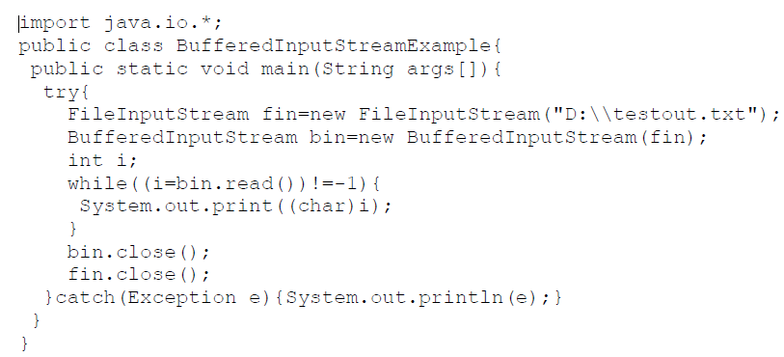

Slide 76
BufferedReader vs Scanner (parsing primitive types)
Scanner
nextInt(), nextFloat(), … for parsing types
BufferedReader
read(), readLine(), … none for parsing types
needs StringTokenizer then wrapper class methods like Integer.parseInt(token)

Slide 77
BufferedReader vs Scanner (Checking End of File/Stream (EOF))
BufferedReader
readLine() returns null
read() returns -1
Scanner
nextLine() throws exception
needs hasNextLine() to check first
nextInt(), hasNextInt(), …

Slide 78
BufferedReader inFile = …
line = inFile.readline();
while (line != null)
{
// …
line = inFile.readline();
}
-------------------
Scanner inFile = …
while (inFile.hasNextLine())
{
line = infile.nextLine();
// …
}

Slide 79
BufferedReader inFile = …
line = inFile.readline();
while (line != null)
{
// …
line = inFile.readline();
}
-------------------
BufferedReader inFile = …
while ((line = inFile.readline()) != null)
{
// …
}

Slide 80
suggestion
Use Scanner with File
new Scanner(new File(“in.txt”))
Use hasNext…() to check for EOF
while (inFile.hasNext…())
Use next…() to read
inFile.next…()
Simpler and you are familiar with methods for Scanner

Slide 81
suggestion cont…
File input
Scanner inFile =
new Scanner(new File(“in.txt”));
File output
PrintWriter outFile =
new PrintWriter(new File(“out.txt”));
outFile.print(), println(), format(), flush(), close(), …
http://www.cs.fit.edu/~pkc/classes/cse1001/FileIO/FileIONew.java

Slide 82
(V) Serialization and Using Object Stream

Slide 83
Using ObjectInputStream

Slide 84
Java File I/O: Object Stream Classes
ObjectInputStream and ObjectOutputStream:
have methods to either read or write data one byte at a time
automatically convert numbers and characters into binary
binary-encoded numeric files (files with numbers) are not readable by a text editor, but store data more efficiently
Remember:
input means data into a program, not the file
similarly, output means data out of a program, not the file

Slide 85
Opening a New Output File
The file name is given as a String
file name rules are determined by your operating system
Opening an output file takes two steps
1. Create a FileOutputStream object associated with the file name String
Connect the FileOutputStream to an ObjectOutputStream object
This can be done in one line of code

Slide 86
Example: Opening an Output File
To open a file named numbers.dat:
ObjectOutputStream outputStream =
new ObjectOutputStream(
new FileOutputStream("numbers.dat"));
The constructor for ObjectOutputStream requires a FileOutputStream argument
The constructor for FileOutputStream requires a String argument
the String argument is the output file name
The following two statements are equivalent to the single statement above:
FileOutputStream middleman = new FileOutputStream("numbers.dat");
ObjectOutputStream outputStream = new ObjectOutputSteam(middleman);

Slide 87
When Using ObjectOutputStream to Output Data to Files:
The output files are binary and can store any of the primitive data types (int, char, double, etc.) and the String type
The files created can be read by other Java programs but are not printable
The Java I/O library must be imported by including the line: import java.io.*;
it contains ObjectOutputStream and other useful class definitions
An IOException might be thrown

Slide 88
Some ObjectOutputStream Methods
You can write data to an output file after it is connected to a stream class
Use methods defined in ObjectOutputStream
writeInt(int n)
writeDouble(double x)
writeBoolean(boolean b)
etc.
See the text for more
Note that each write method throws IOException
eventually we will have to write a catch block for it
Also note that each write method includes the modifier final
final methods cannot be redefined in derived classes

Slide 89
Closing a File
An Output file should be closed when you are done writing to it
Use the close method of the class ObjectOutputStream
For example, to close the file opened in the previous example:
outputStream.close();
If a program ends normally it will close any files that are open

Slide 90
Writing a Character to a File: an Unexpected Little Complexity
The method writeChar has an annoying property:
it takes an int, not a char, argument
But it is easy to fix:
just cast the character to an int
For example, to write the character 'A' to the file opened previously:
outputStream.writeChar((int) 'A');
Or, just use the automatic conversion from char to int

Slide 91
Writing a boolean Value to a File
boolean values can be either of two values, true or false
true and false are not just names for the values, they actually are of type boolean
For example, to write the boolean value false to the output file:
outputStream.writeBoolean(false);

Slide 92
Writing Strings to a File: Another Little Unexpected Complexity
Use the writeUTF method to output a value of type String
there is no writeString method
UTF stands for Unicode Text Format
a special version of Unicode
Unicode: a text (printable) code that uses 2 bytes per character
designed to accommodate languages with a different alphabet or no alphabet (such as Chinese and Japanese)
ASCII: also a text (printable) code, but it uses just 1 byte per character
the most common code for English and languages with a similar alphabet
UTF is a modification of Unicode that uses just one byte for ASCII characters
allows other languages without sacrificing efficiency for ASCII files

Slide 93
When Using ObjectInputStream to Read Data from Files:
Input files are binary and contain any of the primitive data types (int, char, double, etc.) and the String type
The files can be read by Java programs but are not printable
The Java I/O library must be imported including the line: import java.io.*;
it contains ObjectInputStream and other useful class definitions
An IOException might be thrown

Slide 94
Opening a New Input File
Similar to opening an output file, but replace "output" with "input"
The file name is given as a String
file name rules are determined by your operating system
Opening a file takes two steps
1. Creating a FileInputStream object associated with the file name String
2. Connecting the FileInputStream to an ObjectInputStream object
This can be done in one line of code

Slide 95
Example: Opening an Input File
To open a file named numbers.dat:
ObjectInputStream inStream = new ObjectInputStream (new FileInputStream("numbers.dat"));
The constructor for ObjectInputStream requires a FileInputStream argument
The constructor for FileInputStream requires a String argument
the String argument is the input file name
The following two statements are equivalent to the statement at the top of this slide:
FileInputStream middleman = new FileInputStream("numbers.dat");
ObjectInputStream inputStream = new ObjectInputStream (middleman);

Slide 96
Some ObjectInputStream Methods
For every output file method there is a corresponding input file method
You can read data from an input file after it is connected to a stream class
Use methods defined in ObjectInputStream
readInt()
readDouble()
readBoolean()
etc.
See the text for more
Note that each write method throws IOException
Also note that each write method includes the modifier final

Slide 97
Input File Exceptions
A FileNotFoundException is thrown if the file is not found when an attempt is made to open a file
Each read method throws IOException
we still have to write a catch block for it
If a read goes beyond the end of the file an EOFException is thrown

Slide 98
Avoiding Common ObjectInputStream File Errors
There is no error message (or exception)
if you read the wrong data type!
Input files can contain a mix of data types
it is up to the programmer to know their order and use the correct read method
ObjectInputStream works with binary, not text files
As with an output file, close the input file when you are done with it

Slide 99
Common Methods to Test for the End of an Input File
A common programming situation is to read data from an input file but not know how much data the file contains
In these situations you need to check for the end of the file
There are three common ways to test for the end of a file:
1. Put a sentinel value at the end of the file and test for it.
2. Throw and catch an end-of-file exception.
3. Test for a special character that signals the end of the file (text files often have such a character).

Slide 100
The EOFException Class
Many (but not all) methods that read from a file throw an end-of-file exception (EOFException) when they try to read beyond the file
all the ObjectInputStream methods in Display 9.3 do throw it
The end-of-file exception can be used in an "infinite" (while(true)) loop that reads and processes data from the file
the loop terminates when an EOFException is thrown
The program is written to continue normally after the EOFException has been caught

Slide 101
Using EOFException
main method from
EOFExceptionDemo
Intentional "infinite" loop to process data from input file
Loop exits when end-of-file exception is thrown
Processing continues after EOFException: the input file is closed
Note order of catch blocks:
the most specific is first
and the most general last
Chapter 9
Java: an Introduction to Computer Science & Programming - Walter Savitch
101

Slide 102
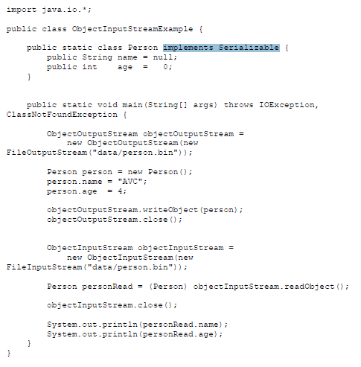

Slide 103
To serialize an object means to convert its state to a byte stream so that the byte stream can be reverted back into a copy of the object.
A Java object is serializable if its class or any of its superclasses implements either the java.io.Serializable interface or its subinterface, java.io.Externalizable.
Deserialization is the process of converting the serialized form of an object back into a copy of the object.
For example, the java.awt.Button class implements the Serializable interface, so you can serialize a java.awt.Button object and store that serialized state in a file.
Later, you can read back the serialized state and deserialize into a java.awt.Button object.

Slide 104
Binary I/O of Class Objects
read and write class objects in binary file
class must be serializable
import java.io.*
implement Serializable interface
add implements Serializable to heading of class definition
methods used:
public class Species implements Serializable
to write object to file:
writeObject method in ObjectOutputStream
to read object from file: readObject method in ObjectInputStream

Slide 105
outputStream = new ObjectOutputStream(
new FileOutputStream("species.records"));
...
Species oneRecord =
new Species("Calif. Condor, 27, 0.02);
...
outputStream.writeObject(oneRecord);
ClassIODemo Excerpts
inputStream = new ObjectInputStream(
new FileInputStream("species.records"));
...
Species readOne = null;
...
readOne = (Species)inputStream.readObject(oneRecord);
readObject returns a reference to type Object so it must be cast to Species before assigning to readOne

Slide 106
The Serializable Interface
Java assigns a serial number to each object written out.
If the same object is written out more than once, after the first write only the serial number will be written.
When an object is read in more than once, then there will be more than one reference to the same object.
If a serializable class has class instance variables then they should also be serializable.
Why aren't all classes made serializable?
security issues: serial number system can make it easier for programmers to get access to object data
doesn't make sense in all cases, e.g., system-dependent data

Slide 107
(VI) Sample code: Student Database

Slide 108
////Sample Student Database
import java.io.*;
class StudentRecords
{
static BufferedReader br = new BufferedReader(new InputStreamReader(System.in));
public void addRecords() throws IOException
{
// Create or Modify a file for Database
PrintWriter pw = new PrintWriter(new BufferedWriter(new
FileWriter("studentRecords.txt",true)));
/*
FileWriter writes directly into file (less performance) and should be used only when number of writes are less. Use PrintWriter to write formatted text to a file.
*/
String name, Class, fname, mname, address, dob;
int age;
long telephoneNo;
String s;
boolean addMore = false;

Slide 109
// Read Data
do
{
System.out.print("\nEnter name: ");
name = br.readLine();
System.out.print("Father's Name: ");
fname = br.readLine();
System.out.print("Mother's Name: ");
mname = br.readLine();
System.out.print("Address: ");
address = br.readLine();
System.out.print("Class: ");
Class = br.readLine();
System.out.print("Date of Birth (dd/mm/yy) : ");
dob = br.readLine();
System.out.print("Age: ");
age = Integer.parseInt(br.readLine());
System.out.print("Telephone No.: ");
telephoneNo = Long.parseLong(br.readLine());

Slide 110
// Print to File
pw.println(name);
pw.println(fname);
pw.println(mname);
pw.println(address);
pw.println(Class);
pw.println(dob);
pw.println(age);
pw.println(telephoneNo);
System.out.print("\nRecords added successfully !\n\nDo you want to add more records ? (y/n) : ");
s = br.readLine();
if(s.equalsIgnoreCase("y"))
{
addMore = true;
System.out.println();
}
else
addMore = false;
}
while(addMore);
pw.close();
showMenu();
}

Slide 111
public void readRecords() throws IOException {
try {
// Open the file
BufferedReader file = new BufferedReader(new FileReader("studentRecords.txt"));
String name;
int i=1;
// Read records from the file
while((name = file.readLine()) != null) {
System.out.println("S.No. : " +(i++));
System.out.println("-------------");
System.out.println("\nName: " +name);
System.out.println("Father's Name : "+file.readLine());
System.out.println("Mother's Name : "+file.readLine());
System.out.println("Address: "+file.readLine());
System.out.println("Class: "+file.readLine());
System.out.println("Date of Birth : "+file.readLine());
System.out.println("Age: "+Integer.parseInt(file.readLine()));
System.out.println("Tel. No.: "+Long.parseLong(file.readLine()));
System.out.println();
}
file.close();
showMenu();
}

Slide 112
catch(FileNotFoundException e)
{
System.out.println("\nERROR : File not Found !!!");
}
}
public void clear() throws IOException
{
// Create a blank file
PrintWriter pw = new PrintWriter(new BufferedWriter(new
FileWriter("studentRecords.txt")));
pw.close();
System.out.println("\nAll Records cleared successfully !");
for(int i=0;i<999999999;i++); // Wait for some time
showMenu();
}

Slide 113
public void showMenu() throws IOException {
System.out.print("1 : Add Records\n2 : Display Records\n3 : Clear All Records\n4 : Exit\n\nYour Choice : ");
int choice = Integer.parseInt(br.readLine());
switch(choice) {
case 1:
addRecords();
break;
case 2:
readRecords();
break;
case 3:
clear();
break;
case 4:
System.exit(1);
break;
default:
System.out.println("\nInvalid Choice !");
break; } }
public static void main(String args[]) throws IOException {
StudentRecords call = new StudentRecords();
call.showMenu(); }}

